Slide 1
Work report
2021/03/11

Slide 2
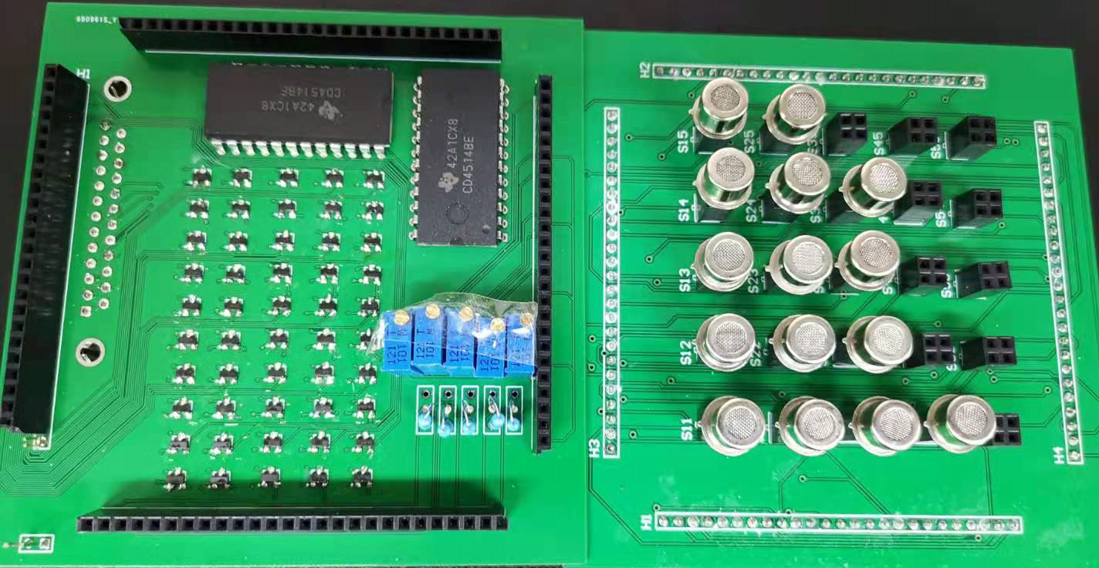
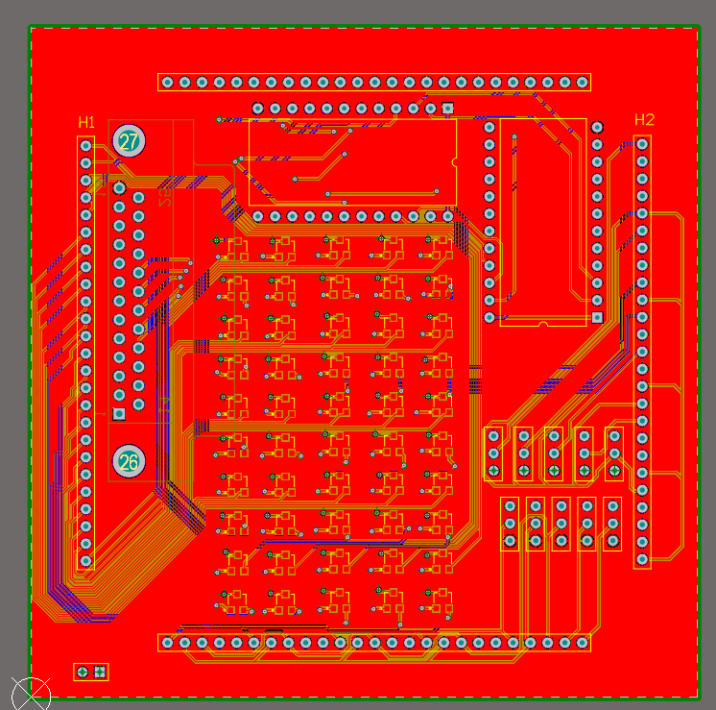
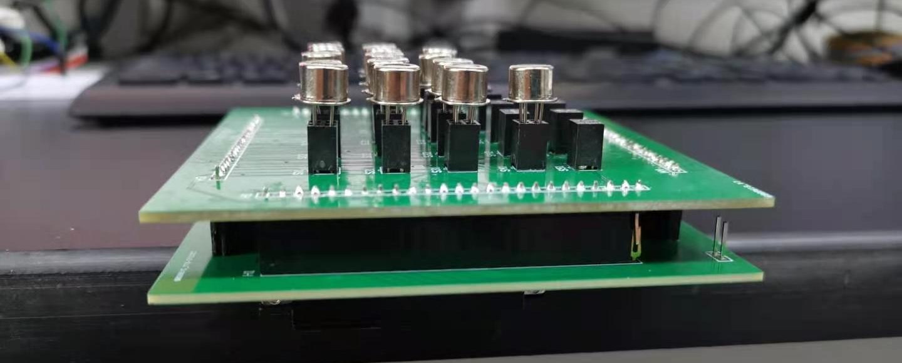
Hardware
Decode chip
Triode array
Variable resistor

Slide 3
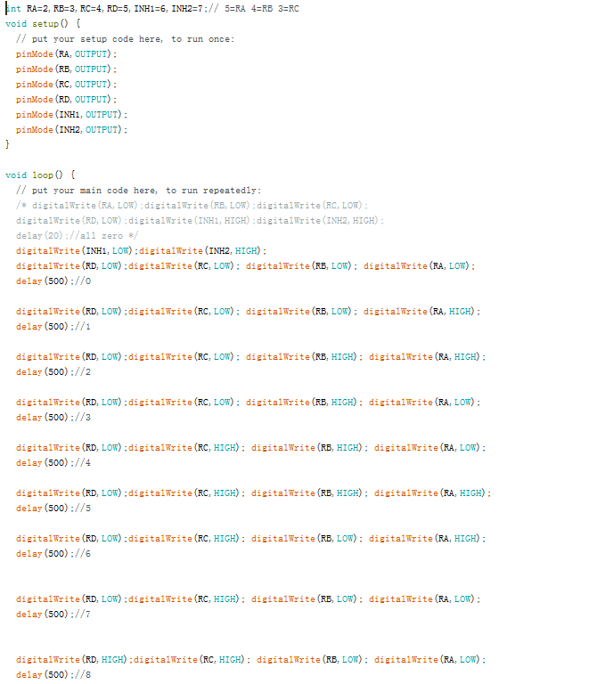

Software of scan signal

Slide 4
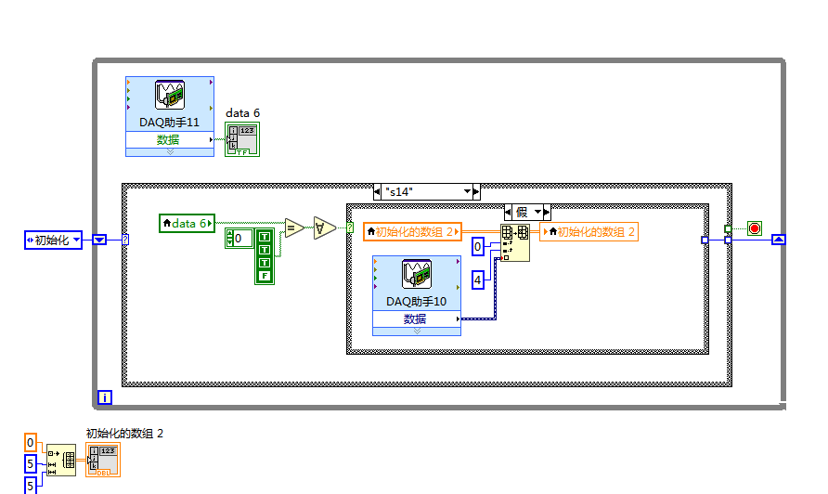
software of reading data

Slide 5
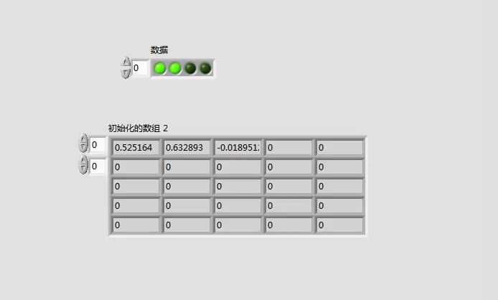
sensor test in air 3sec/sensor

Slide 6
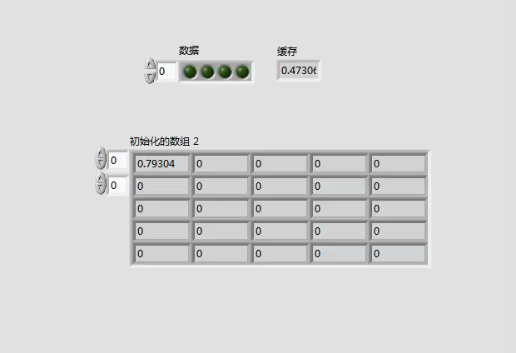
sensor test in gas 3sec/sensor

Slide 7
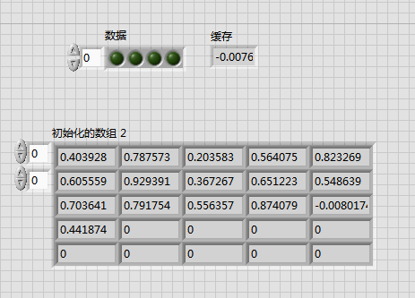
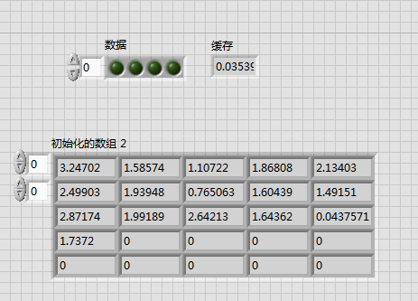
sensor test 2sec/sensor
air
gas

Slide 8
Discuss rapid sensing

Slide 9
Test method
Assume the maximum current of the supply : 1A pre-heating time : 2s
heating current 100mA/sensor
test speed
0.2S
heating time = 2s

Slide 10
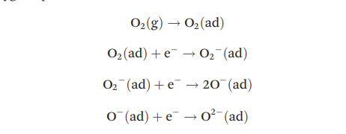
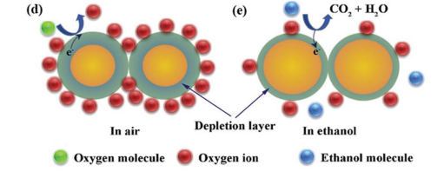

The sensing mechanism
When oxygen molecules are adsorbed on the surface of SnO2, they will occupy the previously formed oxygen vacancies and take electrons from the material conduction band to form negative oxygen species.
Since the electrons in the conduction band are consumed,an electron depletion layer is formed (Fig. 5d). When the thickness of nanoscale SnO2 is less than twice the Debye length(LD), the electron depletion layer will extend to the entire
material, and thus the electrical signal changes will reach a maximum

Slide 11
Future plan
New test method need to be designed
Feasibility analysis of reducing electron depletion layer

